Slide 1
Ch 8 review

Slide 2
1. Uses the chemical energy in food to give the organism’s cells energy
Mitochondria
Chloroplast
[Default]
[MC Any]
[MC All]

Slide 3
2. The ability to do work is…
Active site
Autotrophs
Enzymes
Energy
[Default]
[MC Any]
[MC All]

Slide 4
3. Organisms that cannot make their own food
Autotrophs
Heterotrophs
Enzymes
Metabolism
[Default]
[MC Any]
[MC All]

Slide 5
What is the useful product of the Calvin cycle?
[Default]
[MC Any]
[MC All]

Slide 6
5. What is the correct sequence of events in cellular respiration?
This is not multiple choice
1____
2____
3____
[Default]
[MC Any]
[MC All]

Slide 7
The electron transport chain (or light dependent reactions) in photosynthesis requires the two substances in order to begin
[Default]
[MC Any]
[MC All]

Slide 8
7. Organisms that can make their own food
Autotrophs
Heterotrophs
Enzymes
Metabolism
[Default]
[MC Any]
[MC All]

Slide 9
Name the process that uses Glucose to make Pyruvic Acid?
Answer this first, One word
Is this (A) photosynthesis or (B)cell respiration?
[Default]
[MC Any]
[MC All]

Slide 10
where the Carbon Dioxide coming from the cat goes
Atmosphere
Plant
Chloroplast
Sugar
Animal
CO2
[Default]
[MC Any]
[MC All]

Slide 11
9. Which picture is the substrate?
A
B
C
D
E
[Default]
[MC Any]
[MC All]

Slide 12
10. In the enzyme-controlled reaction represented by the word equation below, which molecules are considered the substrate? monosaccharide + monosaccharide → disaccharide + water
monosaccharide and monosaccharide
disaccharide and water
monosaccharide and water
monosaccharide and disaccharide
[Default]
[MC Any]
[MC All]

Slide 13
11. Which picture is the active site?
A
B
C
D
E
[Default]
[MC Any]
[MC All]

Slide 14
12. In what conditions do enzymes work best?
Extreme temperature range and a low pH (acidic) conditions
Narrow temperature range and a narrow pH conditions
Extreme temperature range and a narrow pH conditions
Narrow temperature range and a high pH (basic) conditions
[Default]
[MC Any]
[MC All]

Slide 15
13. What is the equation for photosynthesis?
6CO₂ + 6H₂0 + (light energy) -> C₆H₁₂O₆ + 6O2
C₆H₁₂O₆ + 6O₂ -> 6CO₂ + 6H₂0 (+ 38 ATP)
CO₂ + 6O₂ -> C₆H₁₂O₆ + (light energy)
CO₂ + 6O₂ -> C₆H₁₂O₆ + 6O₂ + (light energy)
[Default]
[MC Any]
[MC All]

Slide 16
14. Where in the cell does photosynthesis occur?
mitochondria
chloroplast
nucleus
ribosomes
[Default]
[MC Any]
[MC All]

Slide 17
15. What is the light absorbing molecule found in plants?
Chlorophyll
Chloroplast
ATP
Mitochondria
[Default]
[MC Any]
[MC All]

Slide 18
16. The picture shows a student’s experiment with Elodea, a common aquatic plant. Which change in this experiment is most likely to increase the volume of oxygen gas that accumulates in the top of the tube?
  Use fewer plants
  Replace the beaker with a larger container
  Move the light source closer to the beaker
  Reduce the amount of water
[Default]
[MC Any]
[MC All]

Slide 19
17. What is the role of cellular respiration in plants?
To absorb carbon dioxide
To release oxygen
To produce ATP
To form glucose
[Default]
[MC Any]
[MC All]

Slide 20
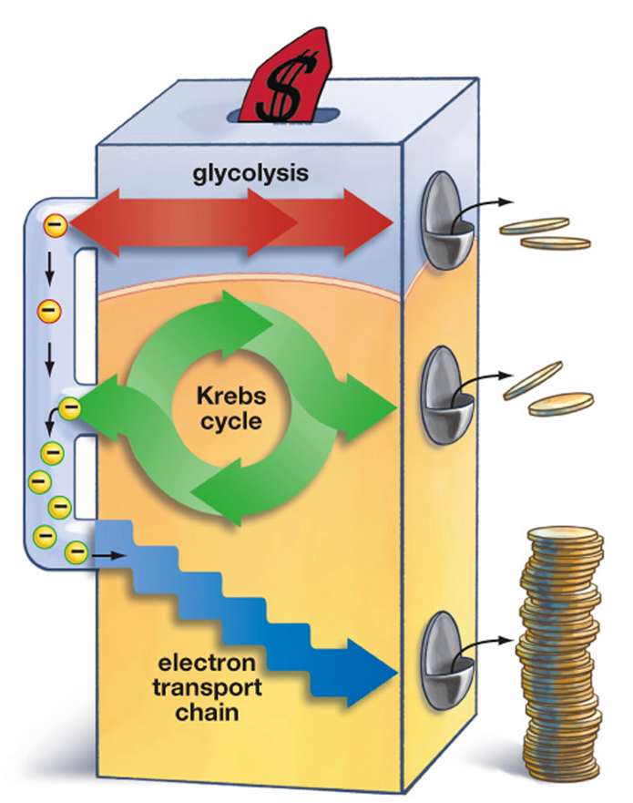
18. Which step produces the most ATP?
Glycolysis
Krebs Cycle
ETC
Photosynthesis
[Default]
[MC Any]
[MC All]

Slide 21
19. In which way are photosynthesis and cellular respiration different?
Cellular respiration stores ATP, while photosynthesis releases ATP
Cellular respiration produces oxygen, while photosynthesis uses oxygen
Photosynthesis releases energy, while cellular respiration stores energy.
Photosynthesis uses carbon dioxide, while cellular respiration produces carbon dioxide
[Default]
[MC Any]
[MC All]

Slide 22
20. By which process is the potential energy of organic molecules transferred to a form of energy that is usable by the cells?
Digestion
Photosynthesis
Hydrolysis
Respiration
[Default]
[MC Any]
[MC All]

Slide 23
21. Energy for most chemical reactions in cells is supplied by which of the following molecules?
Adenosine Triphosphate
Deoxyribose Nucleic acid
Adrenaline
Hemoglobin
[Default]
[MC Any]
[MC All]

Slide 24
22. Where does Glycolysis Occur?
Cytoplasm
Mitochondria
Chloroplast
Ribosome
[Default]
[MC Any]
[MC All]

Slide 25
23. In glycolysis, the first stage of cellular respiration, ATP molecules are produced. What is the net gain of ATP molecules (per molecule of glucose) from glycolysis?
1
2
4
36
[Default]
[MC Any]
[MC All]

Slide 26
24. What is the equation for Cellular Respiration?
6CO₂ + 6H₂0 + (light energy) -> C₆H₁₂O₆ + 6O2
C₆H₁₂O₆ + 6O₂ -> 6CO₂ + 6H₂0 (+ 38 ATP)
CO₂ + 6O₂ -> C₆H₁₂O₆ + (light energy)
CO₂ + 6O₂ -> C₆H₁₂O₆ + 6O₂ + (light energy)
[Default]
[MC Any]
[MC All]

Slide 27
25. Glucose is a product of
Process A only
Process B only
Process B and C
Process A and C
[Default]
[MC Any]
[MC All]

Slide 28
26. What is the function of mitochondria?
to make new DNA through DNA replication
to make protein through the process of translation
to convert sunlight into glucose through photosynthesis
to convert pyruvate into ATP through cellular respiration
[Default]
[MC Any]
[MC All]

Slide 29
27. Process A is known as
Photosynthesis
Fermentation
Dehydration synthesis
Aerobic respiration
[Default]
[MC Any]
[MC All]

Slide 30
28. Which statement best distinguishes aerobic from anaerobic respiration?
Only aerobic respiration involves fermentation
Only anaerobic respiration occurs in the mitochondria
Only aerobic respiration requires oxygen
Only anaerobic respiration produces carbon dioxide
[Default]
[MC Any]
[MC All]

Slide 31
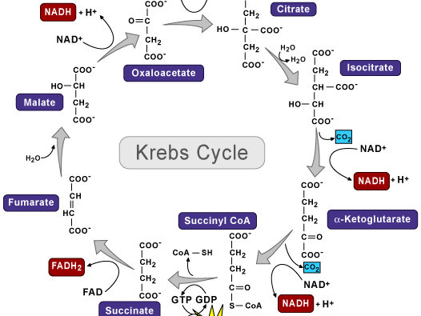
29. Where in the cell does the Krebs Cycle take place?
Chloroplast
Cytoplasm
Mitochondria
Ribosome
Nucleus
[Default]
[MC Any]
[MC All]

Slide 32
30. How many ATP’s are produced in Krebs Cycle?
2
4
32-34
36-38
[Default]
[MC Any]
[MC All]

Slide 33
31. What is the waste product produced during the Krebs Cycle?
Glucose
CO2
H2O
O2
[Default]
[MC Any]
[MC All]

Slide 34
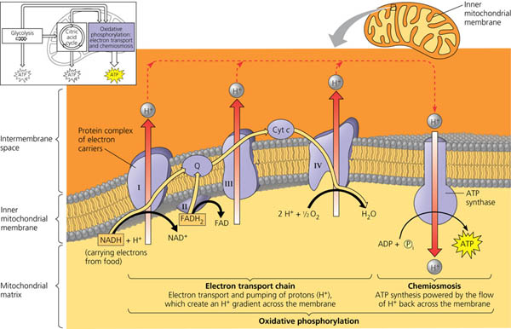
32. Where in the cell does the ETC take place?
Chloroplast
Cytoplasm
Mitochondria
Ribosome
Nucleus
[Default]
[MC Any]
[MC All]

Slide 35
33. What needs to be at the bottom of the ETC to “catch” the high energy electron?
Oxygen
Carbon
Water
Carbon dioxide
[Default]
[MC Any]
[MC All]

Slide 36
34. How many ATP’s are produced in ETC?
2
4
32-34
36-38
[Default]
[MC Any]
[MC All]

Slide 37
35. What is the waste product produced during the ETC?
Glucose
CO2
H2O
O2
[Default]
[MC Any]
[MC All]

Slide 38
36. Which process are aerobic?
Glycolysis
Krebs Cycle
Electron Transport Chain
Photosynthesis
Both B & C
[Default]
[MC Any]
[MC All]

Slide 39
37. When oxygen is not present in the cell what cellular process does the cell switch to, to keep it alive?
Cellular Respiration
Lactic Acid Fermentation
Alcoholic Fermentation
Krebs Cycle

Slide 40
38. How much ATP is produced during Fermentation?
2
4
32
36
[Default]
[MC Any]
[MC All]

Slide 41
39. Where does Alcoholic Fermentation occur?
Yeast
Human Muscle Cells
Bacteria
[Default]
[MC Any]
[MC All]

Slide 42
40. What is not produced during Alcoholic Fermentation
Wine
Yogurt
Bread
Beer
[Default]
[MC Any]
[MC All]

Slide 43
41. How much ATP is produced if you are given 6 molecules of glucose and NO Oxygen is present?
6
12
36
216
[Default]
[MC Any]
[MC All]

Slide 44
42. What type of Fermentation do Humans do?
Lactic Acid
Alcoholic
[Default]
[MC Any]
[MC All]

Slide 45
43. Which of the following is not caused by lactic acid fermentation?
Pain
Soreness
Bread
Fatigue
[Default]
[MC Any]
[MC All]

Slide 46
44. Which of the following is not a location for Lactic Acid Fermentation?
Yeast
Human Muscle Cells
Bacteria
[Default]
[MC Any]
[MC All]

Slide 47
45. What is produced when Lactic Acid Fermentation occurs in Bacteria
Pain, soreness & fatigue
Bread, beer & wine
Yogurt & cheese
Cream cheese and butter
[Default]
[MC Any]
[MC All]

Slide 48
46. If you are given 2 molecules of glucose how many ATP are produced when Oxygen is present?
2
32
36
72
[Default]
[MC Any]
[MC All]

Slide 49
47. Which process are anaerobic?
Glycolysis
Fermentation
Krebs Cycle
Electron Transport Chain
Both A&B
[Default]
[MC Any]
[MC All]

Slide 50
Answers!
D
D
B
A
C
E
A
D
B
A
C
B
A
B
A
C
C
C
D
D
A
A
B
B
B
D
D
C
C
A
B
C
A
C
C
E
B
A
D
B
B
A
C
A
C
D
E

Slide 51
GRADES!!!
98
96
94
91
89
87
85
83
81
97
77
74
72
70
68
66
64
62
60
57
55
53
51
49
47
45
43
40
38
36
34
32
30
28

