Slide 1
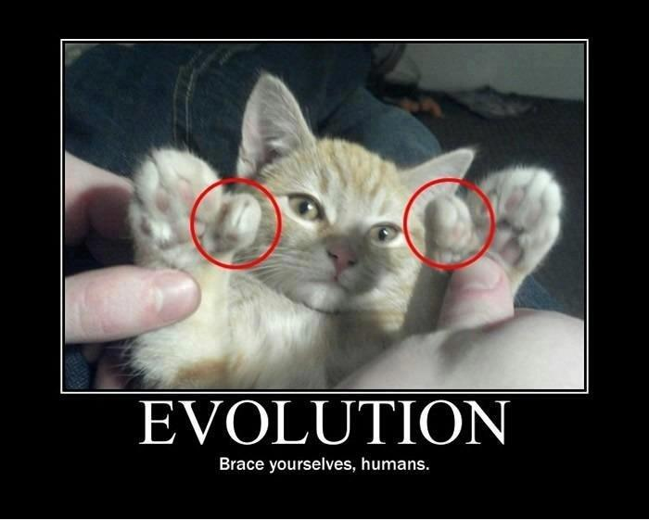
Warm Up… in your notes.
What are the two types of Genetic Drift?
-Can you give an example of each??
2. Explain the Hardy-Weinberg principle (genetic equilibrium) and
how our Finch population does not follow it. (what happens to
allele frequencies?)
LT: I can identify and give examples of the Mechanics of Evolution

Slide 2
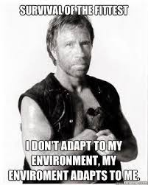
Warm Up (9/27)
Identify the scenario with a type of Mechanics of Evolution
Genetic Drift: small pop. change
A. Bottleneck (massive die off reducing geen pool)
B. Founder Effect (isolation of a small population(geen pool) that then reproduces)
C. Gene Flow (immigration, emmigration)
Natural Selection, (three types)
D. Directional
E. Disruptive
F. Stabalizing
G. Sexual Selection (chicks dig it, or dudes)
H. Mutations (caused by a change in a gene or a chromosome. hills have eyes)
LT: I can identify and apply the Mechanics of Evolution

Slide 3
Warm Up (9/27)
A bizarre clip of two burly bulls has divided opinion on social media - with users claiming their exaggerated body shapes are the result of steroid injections. But while some cattle may be subjected to this shocking treatment to make their meat more valuable, some are simply born this way, it's claimed. One breed, the Belgian Blue, are born with a genetic mutation which causes their muscles to more than double in size, instead of enlarging at a normal rate. They also have an increased ability to convert food into lean muscle, rather than fat -
LT: I can identify and apply the Mechanics of Evolution

Slide 4
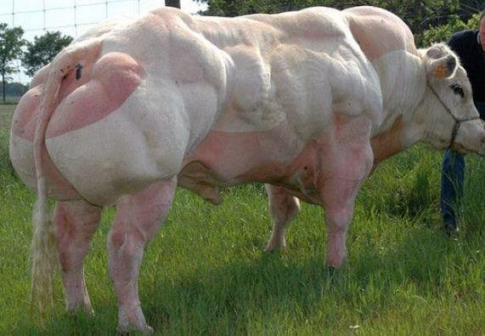
Warm Up (9/27)
Identify the scenario with a type of Mechanics of Evolution (Genetic Drift: Bottleneck/Founder Effect, Gene Flow, Natural Selection, Sexual Selection, Mutations.
LT: I can identify and apply the Mechanics of Evolution

Slide 5
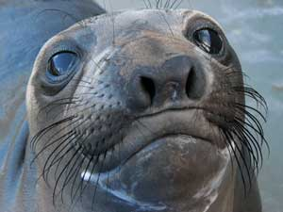
Scenario 1:
“Northern Elephant Seals have reduced genetic variation due to being hunted nearly to extinction. There was said to be as few as 20 left in the wild at the end of the 19th century.”

Slide 6
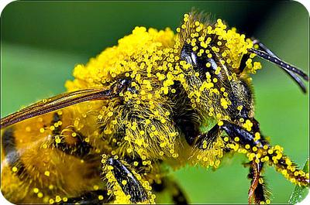
Scenario 2:
“A bee pollinates one flower on the other side of a lake and carries that pollen to another population of flowers on the other side of the lake.”

Slide 7
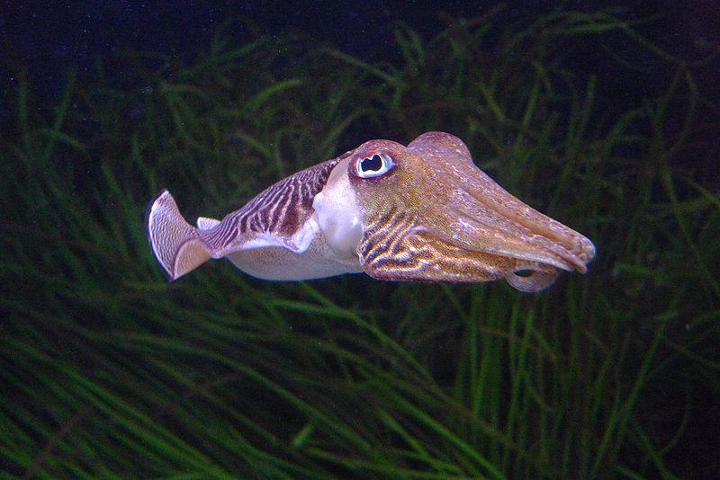
Scenario 3:
“Cuttlefish can be either very big (the biggest can fight off the others to mate) or really small (to sneak in unseen by other cuttlefish to mate). So it is advantageous to be either really big or really small as a cuttlefish, and the medium-sized fish die off.”

Slide 8
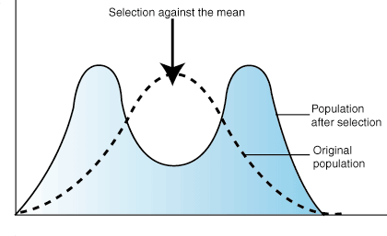
Disruptive Selection

Slide 9
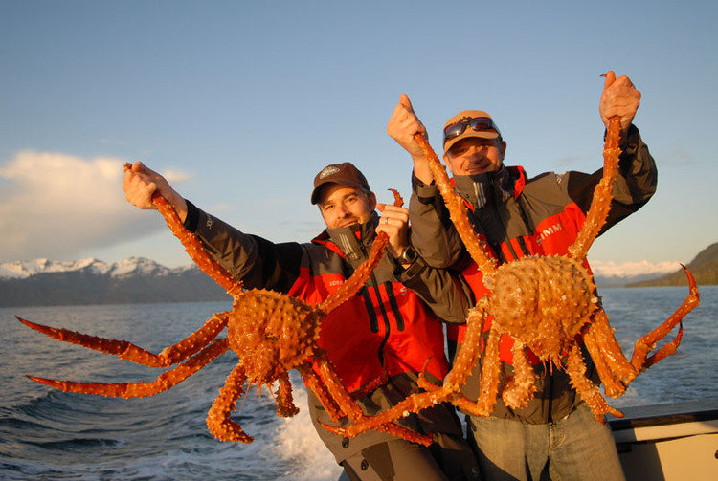
Scenario 4:
“A large colony snow crabs live on Iceland. A few of them get seperated and float off to Greenland. These crabs now on Greenland are a small sample size and have less genetic variation than the original population. They are also more likely to pass down their distinctive traits which may not be the average traits in the original population.”

Slide 10
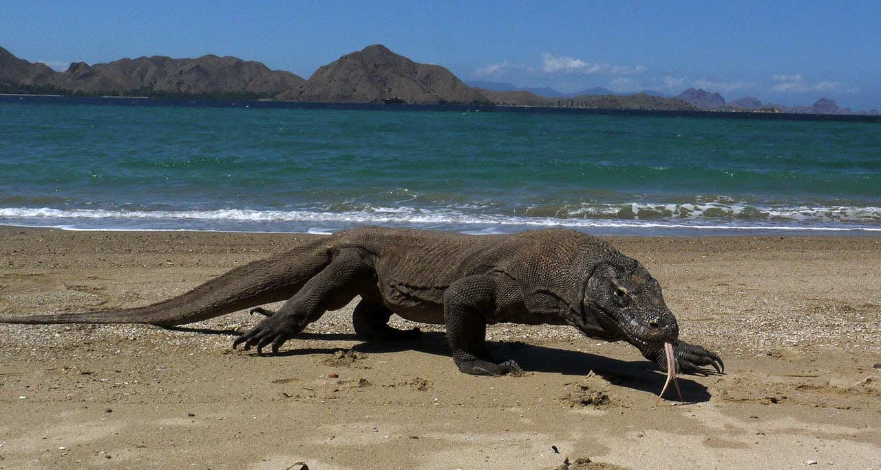
Scenario 5:
“On Komodo Island in Indonesia, the larger claws you have the more likely you will survive a fight and be able to kill prey. As food has become scarce on the island, we have seen a shift from small/medium claws to large claws.”

Slide 11
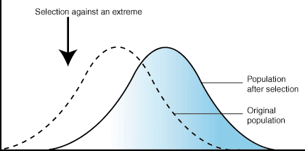
Directional Selection

Slide 12
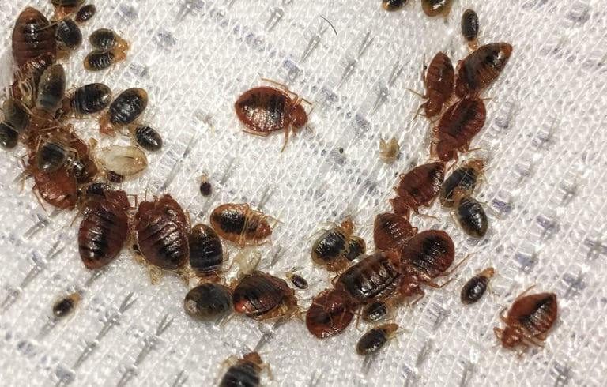
Scenario 6:
“Bed bugs were almost nonexistent in the USA 50 years ago because of the chemical DDT. Although because of this environmental pressure, there were a few bed bugs who became resistant to this form of pesticide at the molecular level and were able to survive.”

Slide 13
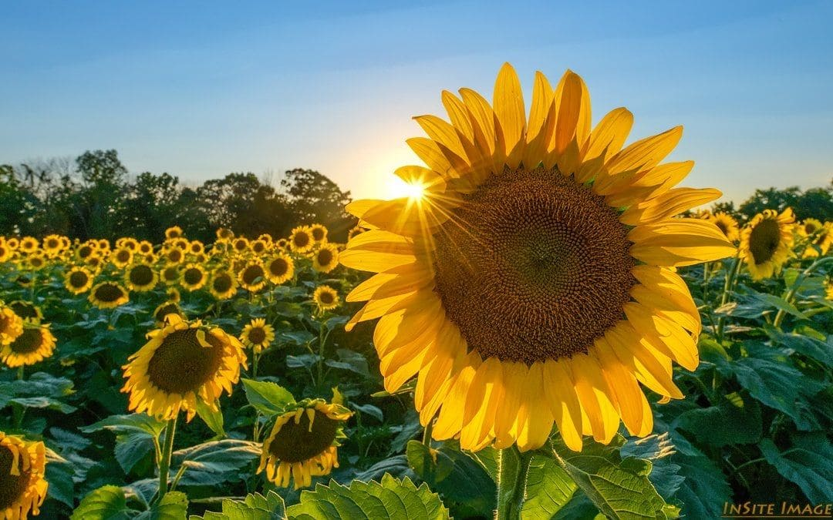
Scenario 7:
“In a colony of Sunflower plants, the really short plants usually die off because they don’t grow tall enough to reach the sunlight. On the other hand, the really tall sunflower plants can easily be killed by wind damage. So sunflowers usually grow to a medium height which is most advantageous.”

Slide 14
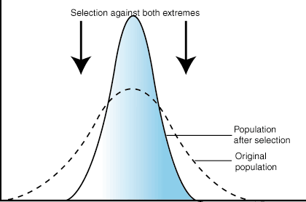
Stabilizing Selection

Slide 15
Scenario 8:
https://www.youtube.com/watch?v=q8zwIphm5r4&authuser=0

