Slide 1
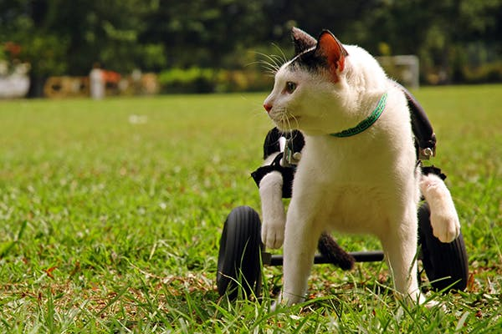
Chapter 2:
LINEAR MOTION

Slide 2
This lecture will help you understand:
Motion in….

Slide 3
This lecture will help you understand:
Scalars and Vectors
Displacement vs Distance
Speed vs Velocity
Motion Is Relative
Speed : Average and Instantaneous
Velocity
Acceleration
Free Fall

Slide 4
Scalar
A SCALAR is ANY quantity in physics that has MAGNITUDE, but NOT a direction associated with it.
Magnitude – A numerical value with units.
Scalar Example | Magnitude
Speed | 20 m/s
Distance | 10 m
Age | 15 years
Heat | 1000 calories

Slide 5
Vector
A VECTOR is ANY quantity in physics that has BOTH MAGNITUDE and DIRECTION.
https://www.youtube.com/watch?v=GKQdkS0qG3g
Vector | Magnitude & Direction
Velocity | 20 m/s, N
Acceleration | 10 m/s/s, E
Force | 5 N, West

Slide 6
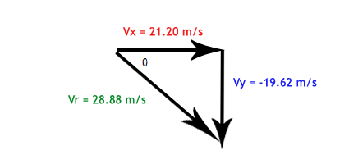
Vectors can be shown by little arrows over quantities in equations or drawings.
You can also break one vector into component vectors, which is what we will do a lot.

Slide 7
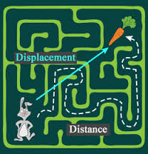
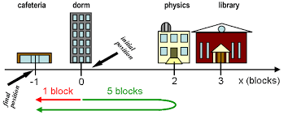
Distance is how far you_______.
Displacement is how far you________.

Slide 8
Distance vs Displacement
1. What is the distance of the race car drivers in the Indy 500? (in miles)
What is the displacement of the race car drivers in the Indy 500? (in miles)

Slide 9
Distance vs displacement
1. What is the displacement of the cross-country team if they begin at the school, run 10 miles and finish back at the school?

Slide 10
Motion Is Relative
Motion of objects is always described as relative to something else. For example:
You walk on the road relative to Earth, but Earth is moving relative to the Sun.
So your motion relative to the Sun is different from your motion relative to Earth.

Slide 11
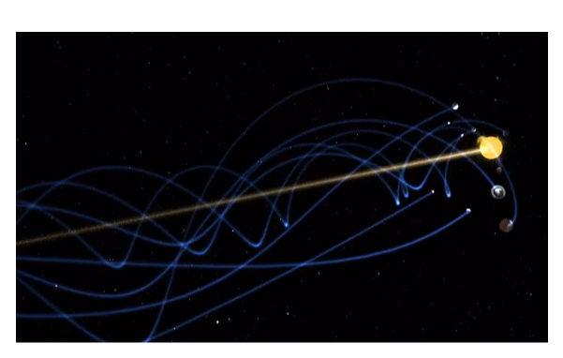
What if we looked at the earth relative to the center of the galaxy??!!
https://www.youtube.com/watch?v=ucLYUYDhgos

Slide 12
Speed
Defined as the distance covered per amount of travel time. Direction or destination is irrelevant!
Units are meters per second. Or any distance divided by any time
In equation form:
Example: A girl runs 4 meters in 2 sec. Her speed is 2 m/s.

Slide 13
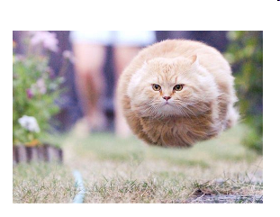
Speed
Mathy definition: Rate of change of distance

Slide 14
Average Speed
The entire distance covered divided by the total travel time
Doesn’t indicate various instantaneous speeds along the way.
In equation form:
Example: Trip to Denver…

Slide 15
Average Speed
CHECK YOUR NEIGHBOR
The average speed of driving 30 km in 1 hour is the same as the average speed of driving
30 km in 1/2 hour.
30 km in 2 hours.
60 km in 1/2 hour.
60 km in 2 hours.

Slide 16
Average Speed
CHECK YOUR ANSWER
The average speed of driving 30 km in 1 hour is the same as the average speed of driving
30 km in 1/2 hour.
30 km in 2 hours.
60 km in 1/2 hour.
60 km in 2 hours.
Explanation:
Average speed = total distance / time
So, average speed = 30 km / 1 h = 30 km/h.
Same
Now, if we drive 60 km in 2 hours:
Average speed = 60 km / 2 h = 30 km/h

Slide 17
Instantaneous Speed
Instantaneous speed is the speed at any instant.
Example:
When you ride in your car, you may speed up and slow down.
Your instantaneous speed is given by your speedometer.

Slide 18
Velocity
A description of
the speed of the object
what direction the object is moving
Velocity is a vector quantity. It has
magnitude: instantaneous speed
direction: direction of object’s motion

Slide 19
Speed and Velocity
Constant speed is steady speed, neither speeding up nor slowing down.
-can be changing direction!
Constant velocity is
constant speed (we will not call zero CONSTANT)
and
constant direction (straight-line path with no acceleration).
.

Slide 20
Acceleration
CHECK YOUR NEIGHBOR
T/F
It is possible to have a constant speed and a changing velocity.

Slide 21
Acceleration
CHECK YOUR NEIGHBOR
T/F
It is possible to have a constant speed and a constant velocity.

Slide 22
Acceleration
CHECK YOUR NEIGHBOR
T/F
It is possible to have a changing speed and a constant velocity.

Slide 23
Acceleration
CHECK YOUR NEIGHBOR
T/F
It is possible to have a changing direction and a constant velocity.

Slide 25
Acceleration
CHECK YOUR NEIGHBOR
T/F
It is possible to have a changing direction and a constant speed.

Slide 26
Acceleration
CHECK YOUR NEIGHBOR
T/F
Speed and velocity are the same thing when direction is ignored.

Slide 27
Acceleration
CHECK YOUR NEIGHBOR
T/F
Speed is the magnitude of velocity.

Slide 28
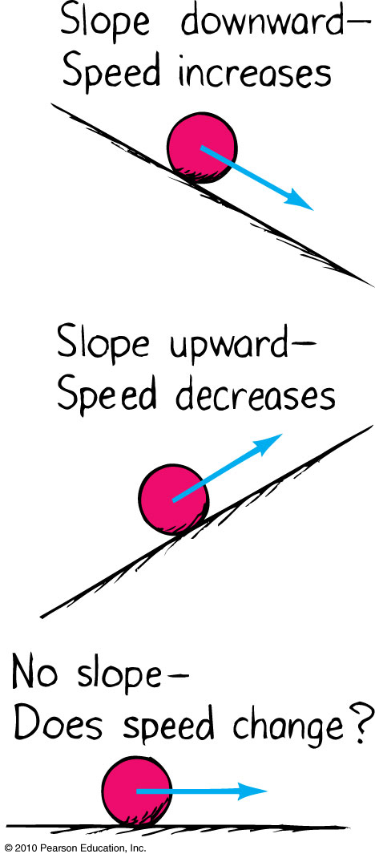
Acceleration
Formulated by Galileo based on his experiments with inclined planes.
Rate at which velocity changes over time
Mathy definition:
Rate of change of velocity

Slide 29
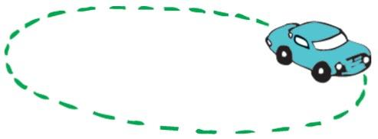
Acceleration
-“Whoop” if you feel it…______________
change in speed, or
change in direction
, or both.
Requires a force
Example: Car making a turn

Slide 30
Acceleration
In equation form:
Unit of acceleration is unit of velocity / unit of time.
Example:
You car’s speed right now is 40 m/s.
Your car’s speed 5 s later is 45 m/s.
Your car’s change in speed is 45 – 40 = 5 m/s.
Your car’s acceleration is = 1 m/s/s.

Slide 31
Don’t say deceleration
In equation form:
Unit of acceleration is unit of velocity / unit of time.
Example:
You car’s speed right now is 40 m/s.
Your car’s speed 5 s later is 10 m/s.
Your car’s change in speed is 10 – 40 = -30 m/s.
Your car’s acceleration (not deceleration) is = -6 m/s/s.

Slide 32
Free Fall
“falling” under the influence of gravity only - with no air resistance. UP or down.
Freely falling objects on Earth accelerate at the rate of 10 m/s/s, i.e., 10 m/s² (more precisely, 9.8 m/s²).

Slide 33
Literacy!!!
In writing explain what acceleration means
What is the difference between velocity and acceleration? (No science or math words!!!)
Word bank: fast, whoop

Slide 34
A cat jumps from a burning kitten factory…
http://www.dailymail.co.uk/news/article-2606977/Caught-camera-Moment-cat-trying-escape-house-fire-jumps-floor-SURVIVES-minutes-roof-collapse.html
How long does the pillow truck have to get in place to catch it?

Slide 35
Pillow delivery truck picture not available
And the kitten lives happily ever after!!!

Slide 36
Kittens being returned
Does it take more time going up or down Toss the ball activity…

Slide 37
Acceleration
CHECK YOUR NEIGHBOR
An automobile is accelerating when it is
slowing down to a stop.
rounding a curve at a steady speed.
Stopped.
Going really fast.
All of the above
A and B only

Slide 38
Acceleration
CHECK YOUR NEIGHBOR
Acceleration and velocity are actually
the same.
rates but for different quantities.
the same when direction is not a factor.
the same when an object is freely falling.

Slide 39
Acceleration
CHECK YOUR NEIGHBOR
Something can be accelerating while the speed is zero.
A. yes
no
both

Slide 40
Acceleration
CHECK YOUR NEIGHBOR
Something can be accelerating while the speed is constant.
A. yes
no

Slide 41
Acceleration
CHECK YOUR NEIGHBOR
something can be accelerating while the velocity is constant.
A. yes
no

Slide 42
Acceleration
CHECK YOUR NEIGHBOR
Something that has zero acceleration must have a constant speed.
A. yes
no

Slide 43
Acceleration
CHECK YOUR NEIGHBOR
The speed of a thing thrown up at the top of it’s flight is.
0m/s
10 m/s
Constant

Slide 44
Acceleration
CHECK YOUR NEIGHBOR
The acceleration of a thing thrown up at the top of it’s flight is.
0m/s
10 m/s²
changing

Slide 45
Acceleration
CHECK YOUR NEIGHBOR
The acceleration of a thing thrown up at the top of it’s flight is.
0m/s²
10 m/s²
changing

Slide 46
Acceleration
CHECK YOUR NEIGHBOR
The velocity of a thing thrown up at the top of it’s flight is.
Remaining constant
10 m/s
changing

Slide 47
Acceleration
CHECK YOUR ANSWER
Acceleration and velocity are actually
the same.
rates but for different quantities.
the same when direction is not a factor.
the same when an object is freely falling.
Explanation:
Velocity is the rate at which distance changes over time,
Acceleration is the rate at which velocity changes over time.

Slide 48
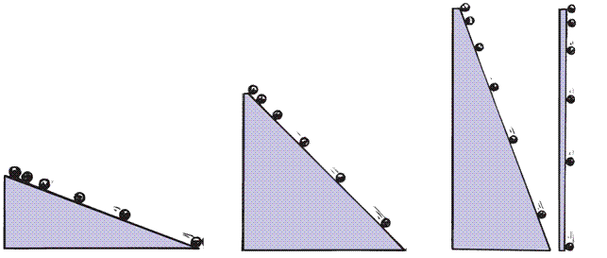
Acceleration
Galileo increased the inclination of inclined planes.
Steeper inclines gave greater accelerations.
When the incline was vertical, acceleration was max, same as that of the falling object.
When air resistance was negligible, all objects fell with the same unchanging acceleration.

Slide 49
Find your hang time
https://www.youtube.com/watch?v=-qTAeVGl_e8

Slide 50
Free Fall
“Falling” under the influence of gravity only - with no air resistance, can be going up or down
Freely falling objects on Earth accelerate at the rate of 10 m/s/s, i.e., 10 m/s² (more precisely, 9.8 m/s²).

Slide 51
Free Fall—How Fast?
CHECK YOUR NEIGHBOR
A falling object has a constant…
A. speed.
velocity.
C. acceleration.

Slide 52
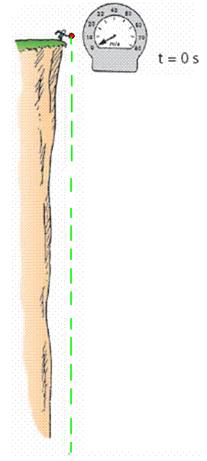
Free Fall—How Fast?
The velocity acquired by an object starting from rest is
So, under free fall, when acceleration is 10 m/s², the speed is
10 m/s after 1 s.
20 m/s after 2 s.
30 m/s after 3 s.
And so on.

Slide 53
Free Fall—How Fast?
CHECK YOUR NEIGHBOR
A free-falling object has a speed of 30 m/s at one instant. Exactly 1 s later its speed will be
the same.
35 m/s.
40 m/s.
60 m/s.

Slide 54
Free Fall—How Fast?
CHECK YOUR ANSWER
A free-falling object has a speed of 30 m/s at one instant. Exactly 1 s later its speed will be
the same.
35 m/s.
more than 35 m/s.
60 m/s.
Explanation:
One second later its speed will be 40 m/s, which is more than 35 m/s.

Slide 55
Free Fall—How Far?
The distance covered by an accelerating object starting from rest is
So, under free fall, when acceleration is 10 m/s², the distance is
5 m after 1 s.
20 m after 2 s.
45 m after 3 s.
And so on.

Slide 56
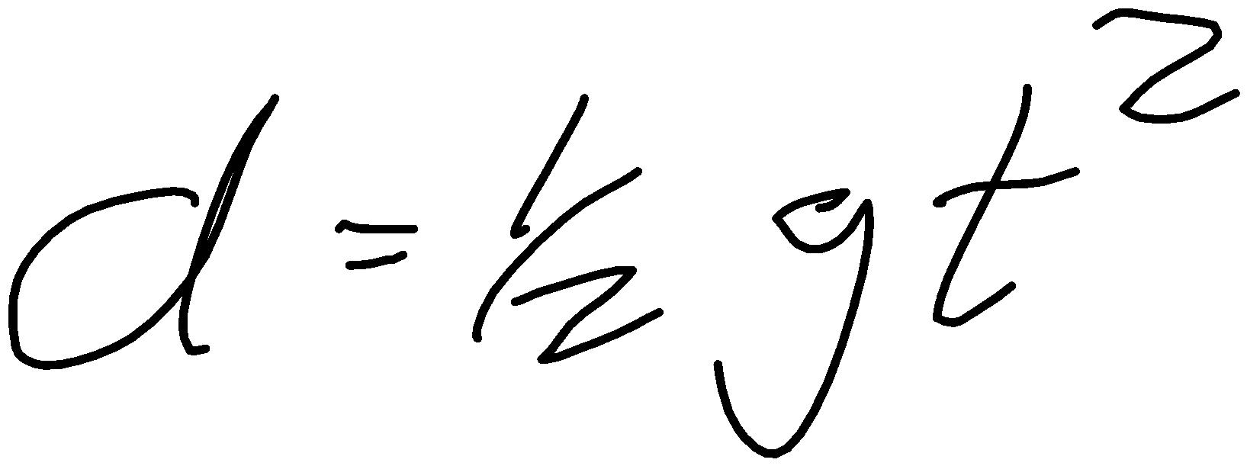
Free Fall—How Far?
CHECK YOUR NEIGHBOR
What is the distance covered of a freely falling object starting from rest after 4 s?
4 m
16 m
40 m
80 m

Slide 57
Free Fall—How Far?
CHECK YOUR NEIGHBOR
What is the displacement of a freely falling object starting from rest after 4 s?
4 m
16 m
40 m
80 m

Slide 58
Free Fall—How Far?
CHECK YOUR NEIGHBOR
If you know how far something has to fall, can you calculate it’s speed?
Yes
No
All of the above
Someone can, but I can’t

Slide 59
Free Fall—How Far?
CHECK YOUR NEIGHBOR
What is the speed of a freely falling object starting from rest after 4 s?
4 m/s
16 m/s
40 m/s
80 m/s

Slide 60
Free Fall—How Far?
CHECK YOUR NEIGHBOR
Calculate the hang time of a turtle that can jump 5m high.

Slide 61
Free Fall—How Far?
CHECK YOUR NEIGHBOR
How high can a turtle jump if his hang time is 1 sec.

Slide 62
Free Fall—How Far?
CHECK YOUR NEIGHBOR
Calculate the hang time of a turtle that can jump 12m high.

Slide 63
Free Fall—How Far?
CHECK YOUR NEIGHBOR
How high can a turtle jump if his hang time is 4sec.

