Slide 1
Can you have negative elastic potential energy?
A) yes
B) no
C) third option

Slide 2
What letter is used to represent the spring constant?

Slide 3
Energy is a _____.
A) scalar
B) vector

Slide 4
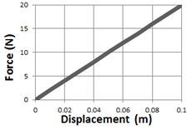
What is the spring constant? A) slope B) area C) integral

