Slide 1
Evolution Unit Review Time!

Slide 2
Natural Selection
4 principles:
Heritability
Variation
Reproductive Advantage
Overproduction
Types:
Stabilizing
Directional
Disruptive

Slide 3
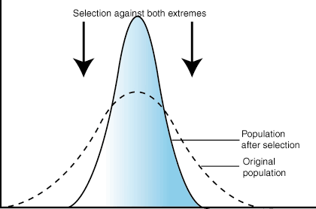

Slide 4
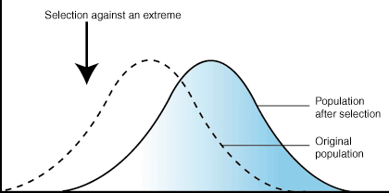

Slide 5
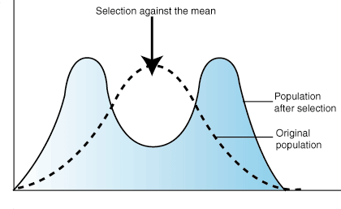

Slide 6
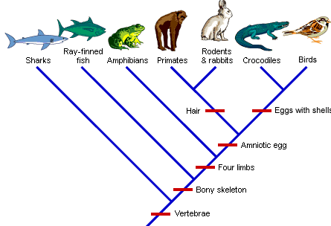

Slide 7
Evidence of Evolution
Anatomy
DNA
Embryology
Fossils

Slide 8
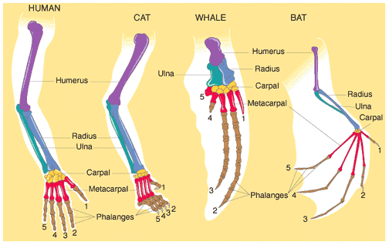
Homologous: same structure/varied function
Notes:
Homologous: same structure/varied function, come from a common ancestor (mammals, reptiles, fish, etc)

Slide 9
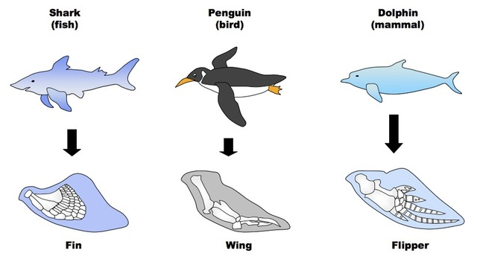
Analogous: similar function/different structure
Notes:
Analogous: similar function/different structure; different common ancestor

Slide 10
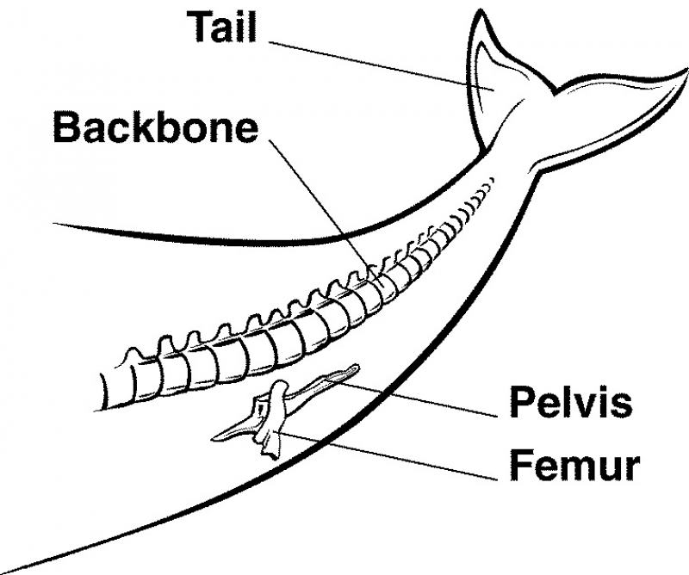
Vestigial: reduced form of a structure; leftover structures, not used anymore.
Notes:
Vestigial: reduced form of a structure; leftover structures, not used anymore. Why would a whale have a femur?

Slide 11
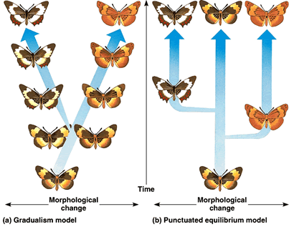
:
Gradualism (left--ex: alligators, Punctuated Equilibrium (right--ex: squirrels, antibiotic resistant bacteria)
Notes:
Rate of evolution: Gradualism (left--ex: alligators, sharks) vs Punctuated Equilibrium (right--ex: squirrels, antibiotic resistant bacteria) caused by any/all 5 mechanisms of evolution

Slide 12
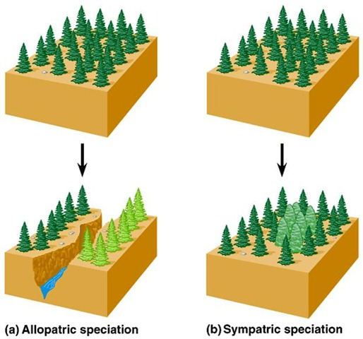
Speciation is how a new kind of plant or animal species is created
Two types of speciation:
allopatric
sympatric.
Rate of evolution:
Gradualism (left--ex: alligators, sharks)
Punctuated Equilibrium
development of many similar species in a single habitat, each with a different specialization.
Notes:
Allopatric (left--PHYSICAL barrier) vs Sympatric (right--NO PHYSICAL barrier; due to errors in numbers of chromosomes [plants], for animals, habitat impact their speciation) speciation

Slide 13
Left and right?
B. when a species divides into separate
groups which are isolated physically
from one another, and a
new species develops.
A. development of many similar species in a single habitat, each with a different specialization.
Notes:
Allopatric (left--PHYSICAL barrier) vs Sympatric (right--NO PHYSICAL barrier; due to errors in numbers of chromosomes [plants], for animals, habitat impact their speciation) speciation

Slide 14
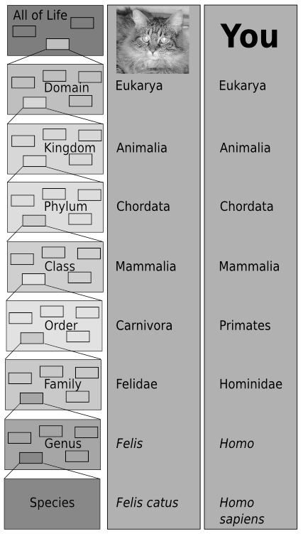
Notes:
Taxonomy

Slide 15
Mechanisms of Evolution
Gene Flow
Genetic Drift (Bottleneck and Founder Effect)
Mutations
Natural Selection
Sexual Selection

Slide 16
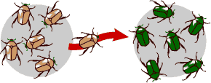
Notes:
Gene flow

Slide 17
Notes:
Bottleneck Effect

Slide 18
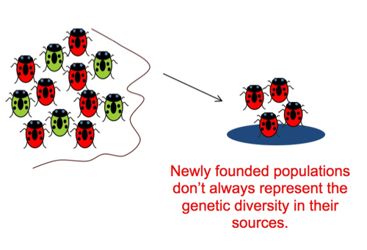
Notes:
Founder effect

Slide 19
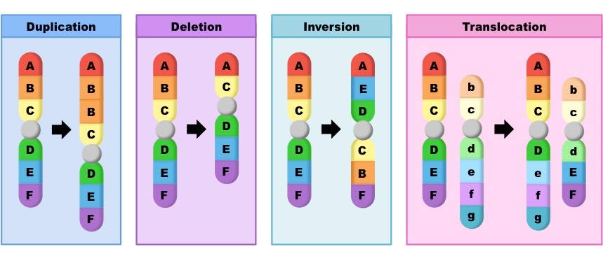
Notes:
Mutations

Slide 20
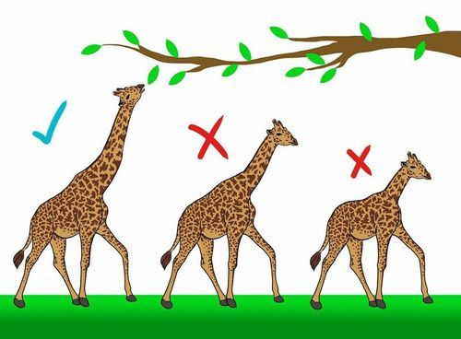
Notes:
Natural Selection

Slide 21
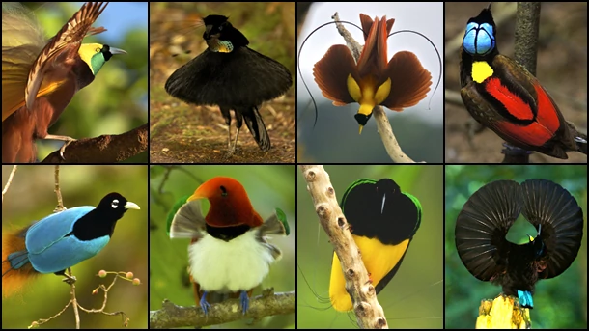
https://www.youtube.com/watch?v=CYcs73oeFkc
Notes:
Ex: sexual selection (ex: behavioral isolation, sexual dimorphism--females look way different than males) PREZYGOTIC BARRIOR
Not necessarily dictated by genetics, but by behavior

