Slide 1
BIOMOLECULES
Notes:
Show ahead of time and post for review: https://www.youtube.com/watch?v=YO244P1e9QM

Slide 2
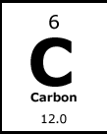
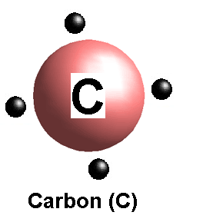
CARBON-based molecules are called BIOMOLECULES
By sharing ELECTRONS, carbon can bond to FOUR other atoms
Other atoms that often bond to Carbon:
HYDROGEN, OXYGEN, NITROGEN

Slide 3
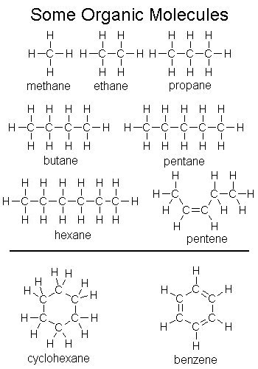
What is a Biomolecule?
Usually forms
RINGS or LONG CHAINS
SHAPE determines FUNCTION (what it does)
Found IN or PRODUCED by LIVING systems

Slide 4
The Biological Molecules
There are FOUR important biological molecules
CARBOHYDRATES
LIPIDS
PROTEINS
NUCLEIC ACIDS
They are often called MACROMOLECULES because of their large size.

Slide 5
Three out of the 4 types of biochemical macromolecules can be found on food nutrition labels.

Slide 6
Can you find:
Fats?
Proteins?
Carbohydrates?

Slide 7
Each of the 4 Biological Molecules is made of a
MONOMER
Definition:
a molecule that can be bonded to identical molecules to form a Polymer
“building blocks”
POLYMERS
Definition:
a substance that is built of 2 or more monomers bonded together
Examples:
carbohydrates, lipids, proteins, nucleic acids

Slide 9
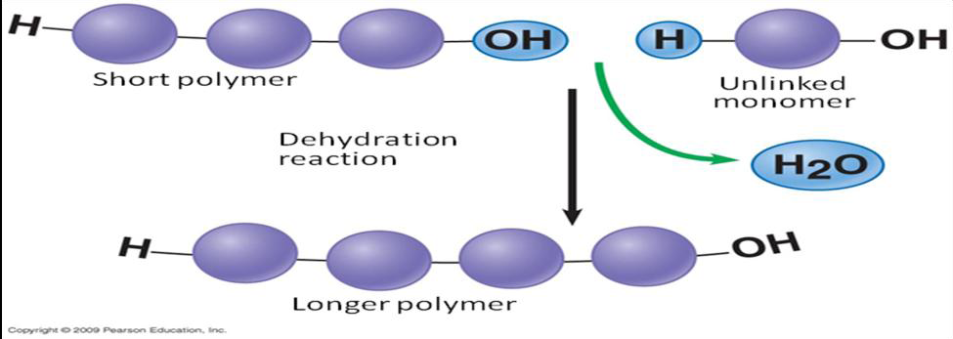
Dehydration Synthesis
POLYMERS are MADE through DEHYDRATION REACTIONS, which REMOVE WATER (dehydration)
This process links together monomers!

Slide 10
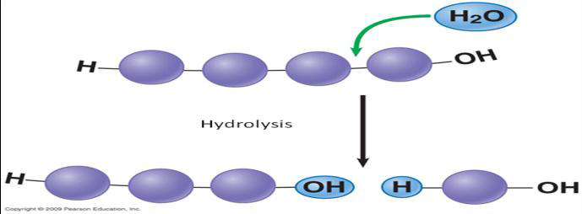
Hydrolysis
POLYMERS are BROKEN apart by HYDROLYSIS, by ADDING WATER
(hydration)

Slide 11
When studying these biomolecules, we are interested in finding out…..
what they do for living things.
what they generally look like.
what their monomers are.
and how they may help the body gain energy to sustain life.

Slide 12
Keep the following in mind when studying this material:
Nucleic Acids -What they look like
Carbohydrates -What they do/Where are
they
Lipids -What are they made up
Proteins of--at the level of atoms

Slide 13
LET’S BEGIN WITH CARBOHYDRATES
WHAT DO THEY DO?
They are the main source for the body to gain energy. They are our fuel!
They make up the cell wall in plants which allow them to grow tall. Without this carbohydrate, a plant would be a mushy mess! This type of carbohydrate is called Cellulose.
THINK: CARBS= ENERGY and CELL WALLS

Slide 14
CARBOHYDRATES
WHERE ARE THEY FOUND?
In plant foods- in the cell walls of plants --- in fruits, vegetables, peas, beans, SUGAR comes from a plant and so does FLOUR! (pasta, potatoes, bread, candy, cookies)
---------------------------------------------------
In animal products- in MILK

Slide 15
CARBOHYDRATES
TYPES
THERE ARE 2 TYPES OF CARBOHYDRATES
Simple
Complex
Notes:
15

Slide 20
CARBOHYDRATES
MADE UP OF...
Carbohydrates are chains (polymers) made of monomers. The most common monomer of carbohydrates is…
GLUCOSE
Notes:
20

Slide 22
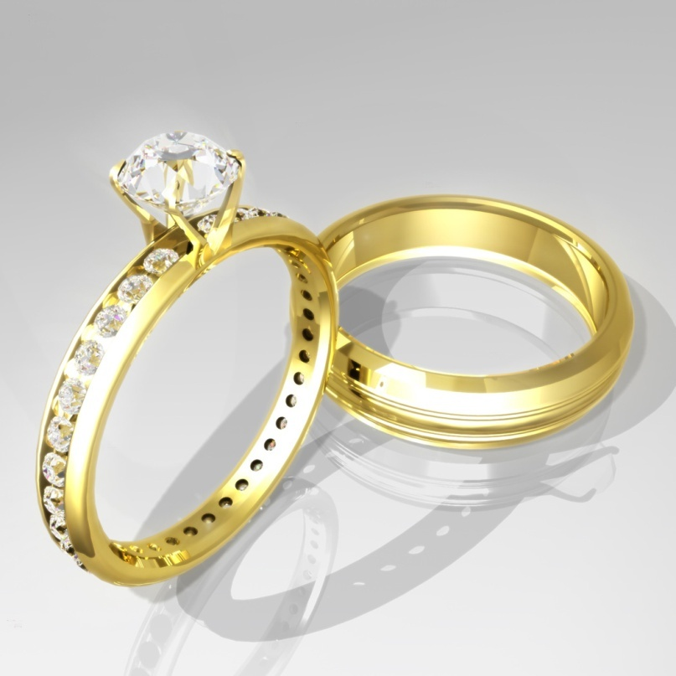
And we all know if you give someone a Ring…
You Are SOOO SWEET!

Slide 23
CARBOHYDRATES
AT THE ATOM LEVEL
Each carbohydrate is made up of…
CARBON, HYDROGEN, AND OXYGEN
THINK: “CHO”
Notes:
23

Slide 24
LIPIDS ARE NEXT
WHAT DO THEY DO?
They are a great source of STORED ENERGY so we have it in the future.
They INSULATE the body to maintain normal body temperature and they CUSHION the internal organs for protection.
They produce hormones for the body called STERIODS
They waterproof surfaces of animals,plants, and fruits- these are waxes!
THINK: Waterproof, insulate, steroids, energy, cushion AKA “WISE C”

Slide 26
LIPIDS…Some interesting info
STEROIDS
There are many different types of steroids. They are all lipids. Their functions vary. Some common steroids are:
SEX STEROIDS ANABOLIC STEROIDS aka
CHOLESTEROL
Like testosterone and estrogen
They increase muscle

Slide 27
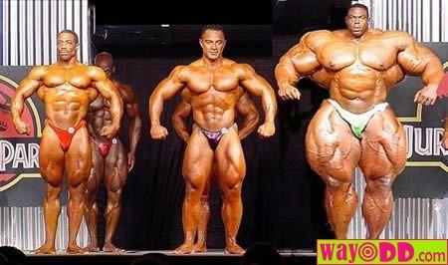
LIPIDS…Some interesting info
Some anabolic steroids are illegal and can be dangerous and very unhealthy
NATURAL STEROIDS IN OUR BODY INCREASE MUSCLE GROWTH AND BONE DEVELOPMENT AND ARE GOOD. THE ILLEGAL ONES THAT ARE SYNTHETIC ARE BAD.

Slide 28
LIPIDS
WHERE ARE THEY FOUND?
In plants- in the seeds
---------------------------------------------------
In animals- in adipose tissue and connective tissue
---------------------------------------------------
Lipids make up the cell membrane of all cells.

Slide 30
LIPIDS
MADE UP OF...
Lipids are chains (polymers) made of monomers. The most common monomer of lipids is…
GLYCEROL AND FATTY ACIDS

Slide 31
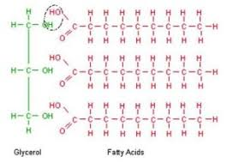
The Shape of a triglyceride is like the letter
E

Slide 32
LIPIDS
AT THE ATOM LEVEL
Each Lipid is made up of…
CARBON, HYDROGEN AND OXYGEN
THINK: “CHO”

Slide 33
OH NO CHO! Are Lipids like Carbs?
You might have noticed that both carbohydrates and lipids have the elements Carbon, Hydrogen, and Oxygen.
“CHO”
A carbohydrate has twice as many hydrogen atoms as the number of oxygen atoms.
EX: C₆H₁₂O₆
(This is a carb= there are double the number of H compared to O)
On the other hand, lipids have a lot more than twice the amount hydrogen atoms as the number of oxygen atoms.
EX: C₂₇H₄₆O cholesterol

Slide 34
NOW ONTO PROTEINS
WHAT DO THEY DO?
They are the major structural molecules in living things for growth and repair : muscles, ligaments, tendons, bones, hair, skin, nails…IN FACT ALL CELL MEMBRANES have protein in them
They make up antibodies in the immune system
They make up enzymes for helping chemical reactions
They makeup non-steroid hormones
THINK: Proteins= membranes, enzymes, antibodies, non-steroid hormones, structural molecules, “MEANS”
Notes:
34

Slide 35
MORE ON PROTEINS…
The following slides give you a little more in depth info on things that are made of proteins…

Slide 42
Enzymes are proteins that speed up chemical reactions. If you didn’t have enzymes in your stomach to speed up digestion, the food would rot in your stomach because it would take so long!
Enzymes

Slide 45
PROTEINS
WHERE ARE THEY FOUND?
In plant foods- in the cell membranes
In animal products- in the cell membranes- in the muscles of living things (cows, chicken, fish…)
Notes:
45

Slide 46
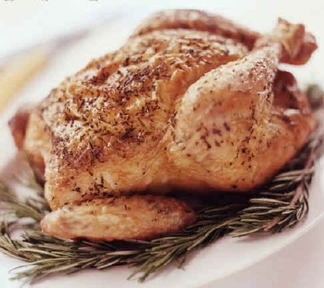
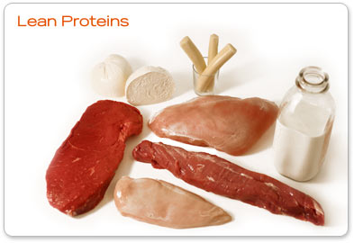
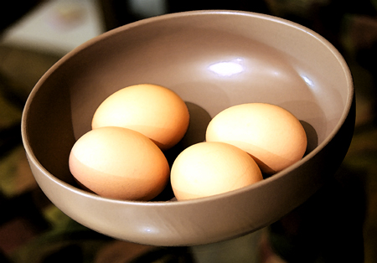
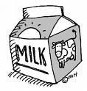
Proteins

Slide 47
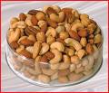
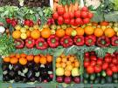
Proteins
Aside from the protein found in animal sources…protein can also be found in fruits, vegetables, grains, and nuts.
(it just does not have as many amino acids)

Slide 48
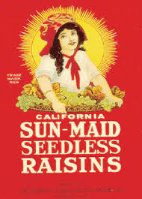
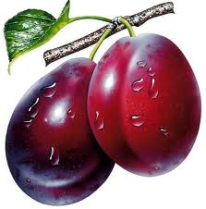
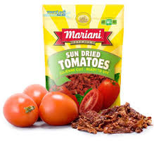
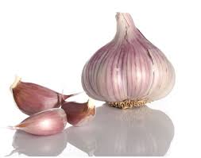
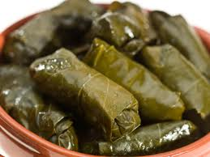
Fruits
Apricots
Prunes
Raisins
Veggies
Sun dried tomatoes
Soybean Sprouts
Garlic
Grape Leaves

Slide 49
PROTEINS
MADE UP OF...
Proteins are made of long chains (polymers) made of monomers. All proteins are made of the monomer…
AMINO ACID

Slide 50
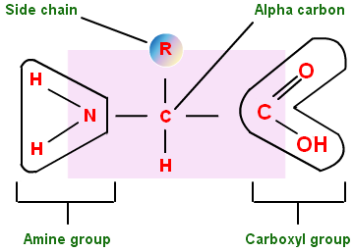
The Shape of Amino Acids
*
Looks like a Star to me

Slide 51
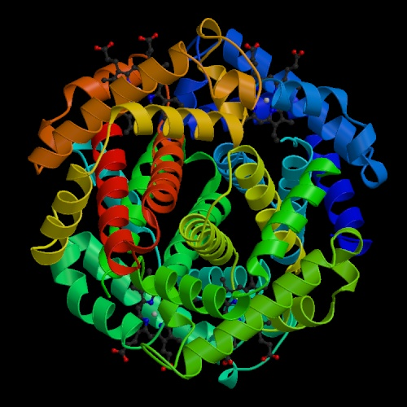
The shapes of proteins are like a balled up piece of string
Amino Acid chain
All wound up

Slide 52
PROTEINS
AT THE ATOM LEVEL
Each protein is made up of…
CARBON, HYDROGEN, OXYGEN, NITROGEN, and sometimes SULFUR
THINK: “CHONS”

Slide 53
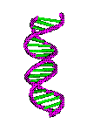
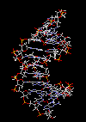
DNA Basics
Double Helix

Slide 54
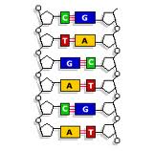
Your DNA is Made of 4 Bases or Nucleotides (monomers)
Thymine - T
Adenine - A
Guanine - G
Cytosine - C

Slide 55
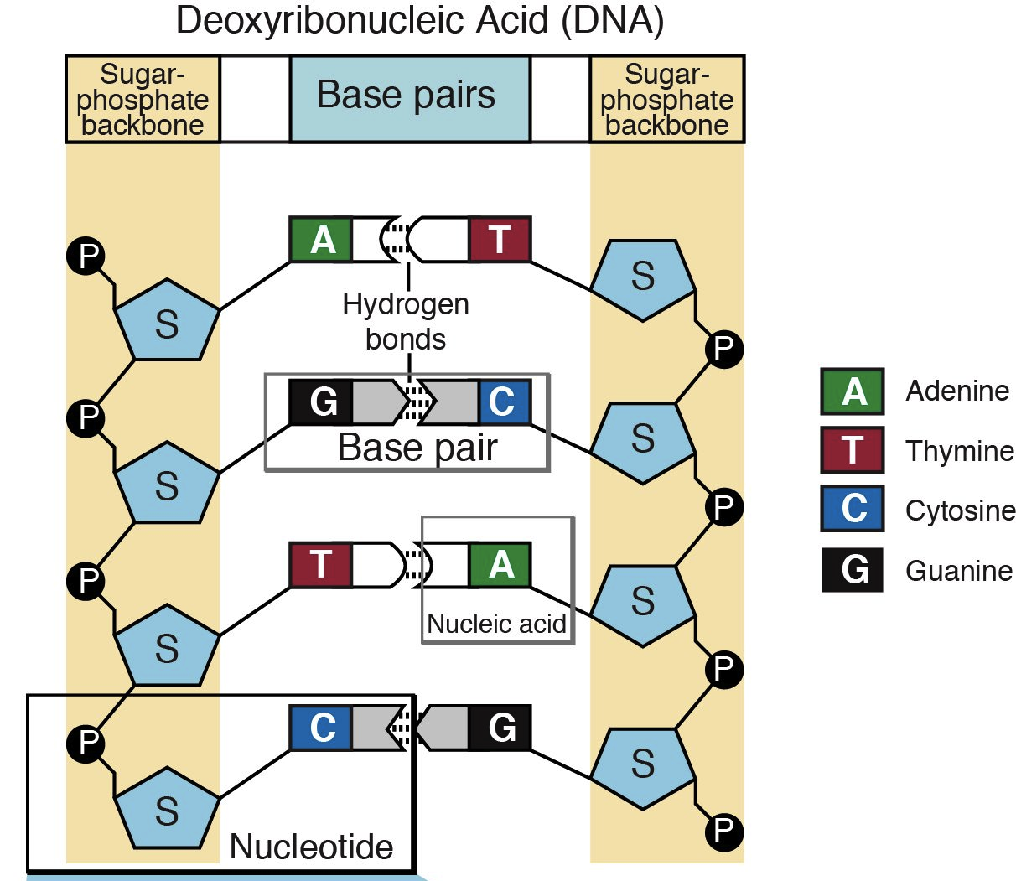

Slide 56
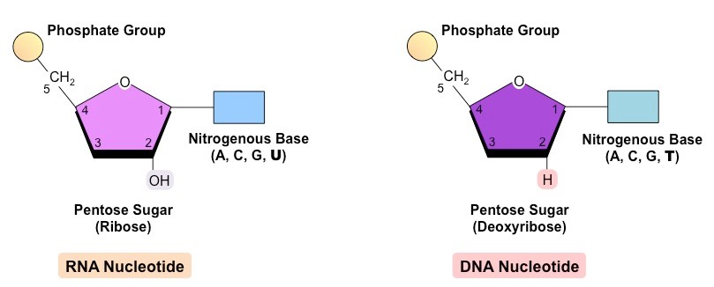
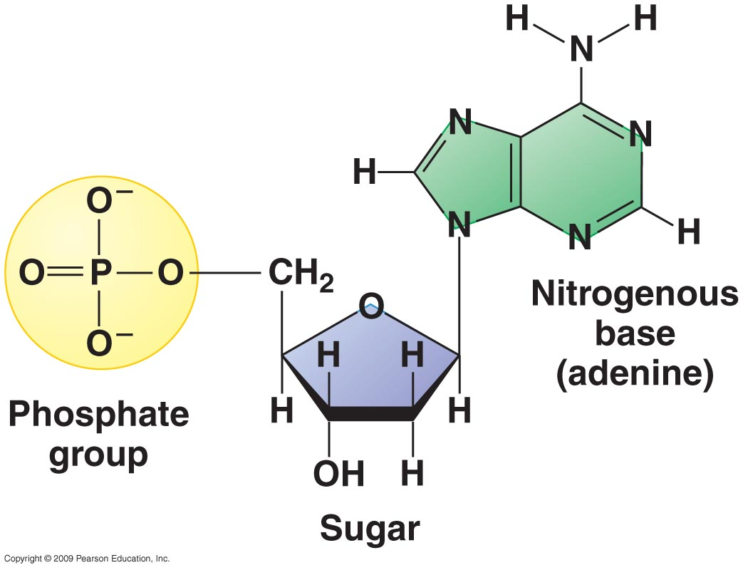
NUCLEIC ACIDS
AT THE ATOM LEVEL
Each NUCLEIC ACID is made up of…
CARBON, HYDROGEN, OXYGEN, NITROGEN, and PHOSPHORUS
THINK: “CHONP”

Slide 57
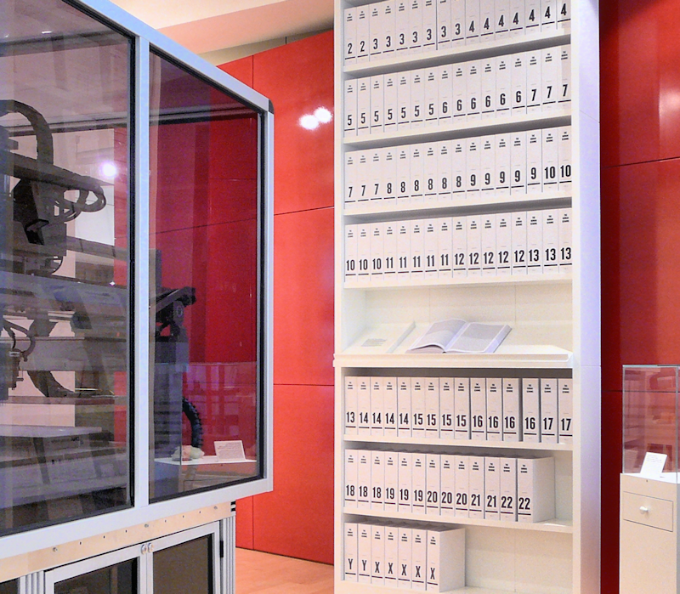
How many pages would it would take to hold the 3 billion letters of the human genome?
http://www.broadinstitute.org/blog/pages-first-human-genome

Slide 58
If a person were typing out the human genome at a relatively quick rate for eight hours every day, it would take more than 50 years to complete the job. However, when a cell replicates, it only takes an average of about eight hours to copy the entire sequence.
only 5% of the 3 billion DNA letters actually produce functional units

Slide 59
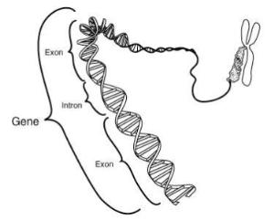
What is a Gene?
Chemical factors that determine Traits
So what is a Trait = Distinguishing features of a person’s character which varies from one person to another

Slide 60
Let’s Review...

Slide 61
As a reminder...

